Slide 1
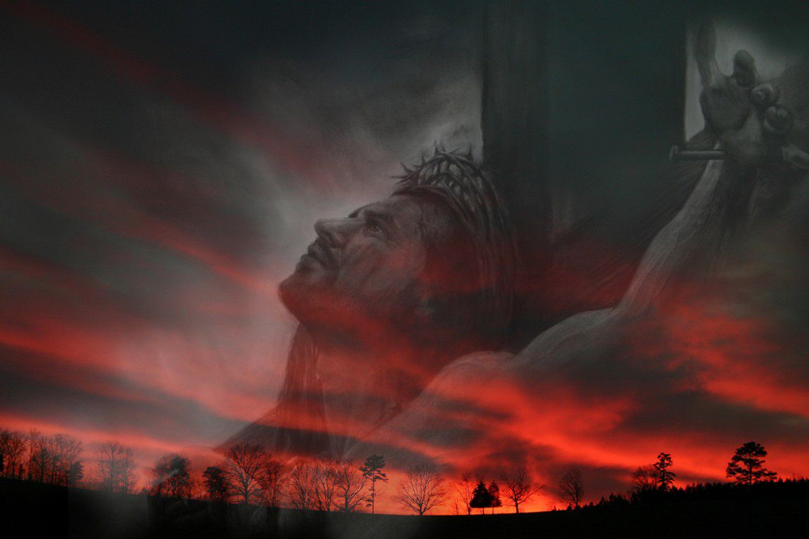
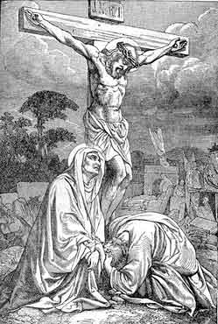
1 fjks ia:dkh
2 fjks ia:dkh
3 fjks ia:dkh
fufkyslsrsu
4 fjks ia:dkh
5 fjks ia:dkh
6 fjks ia:dkh
7 fjks ia:dkh
8 fjks ia:dkh
9 fjks ia:dkh
fufkyslsrsu
10 fjks ia:dkh
11 fjks ia:dkh
12 fjks ia:dkh

Slide 2
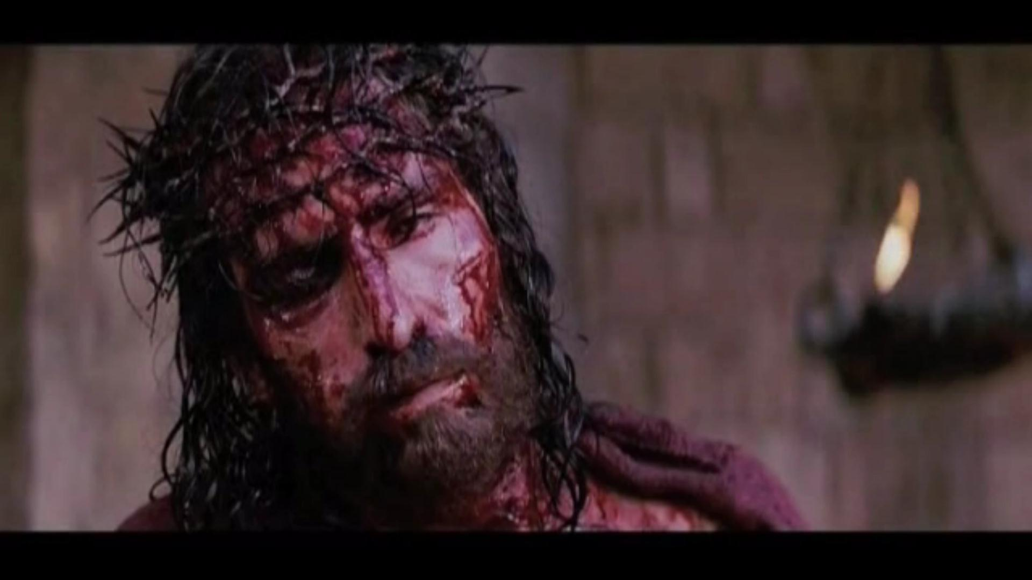
fÊiq iajdñ orefjda urKhg
;skaÿj ,nk fial

Slide 4
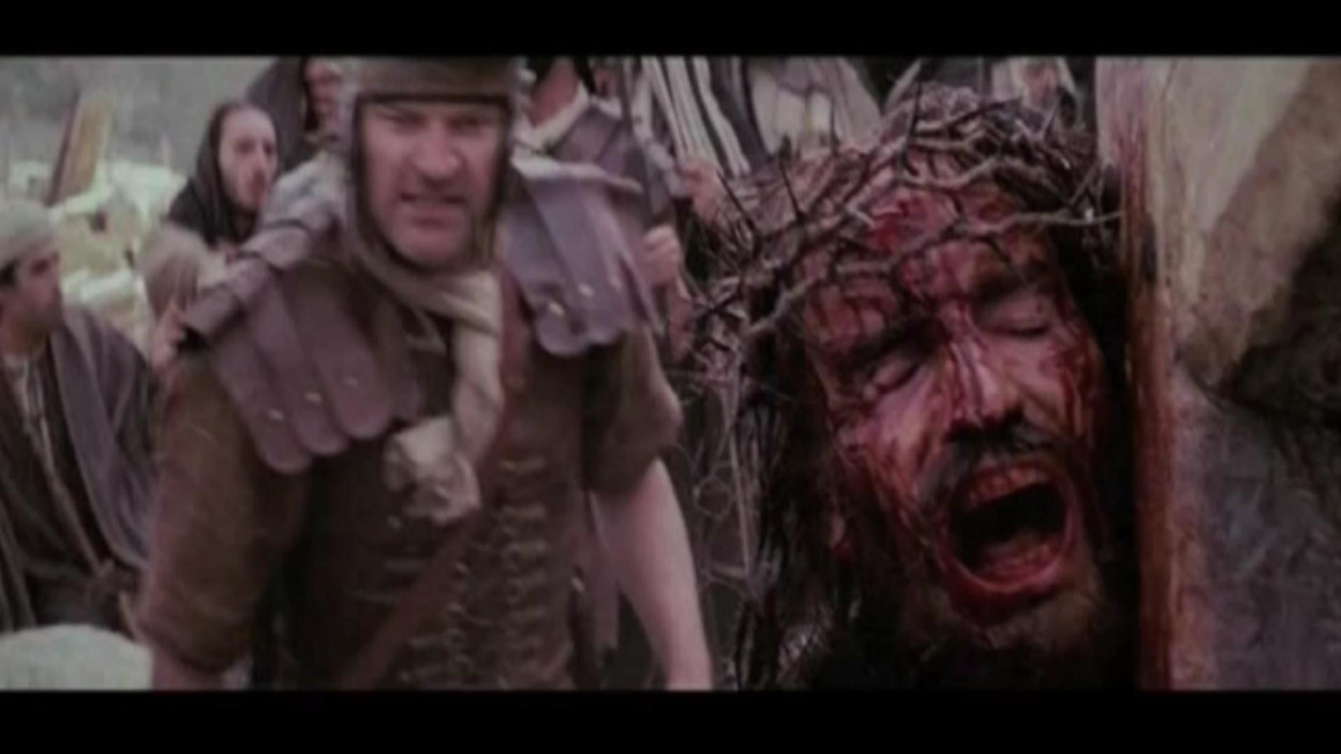
cqofhda fÊiq iajdñorejkaf.a Y%S lrmsg l=reih ;n;s

Slide 6
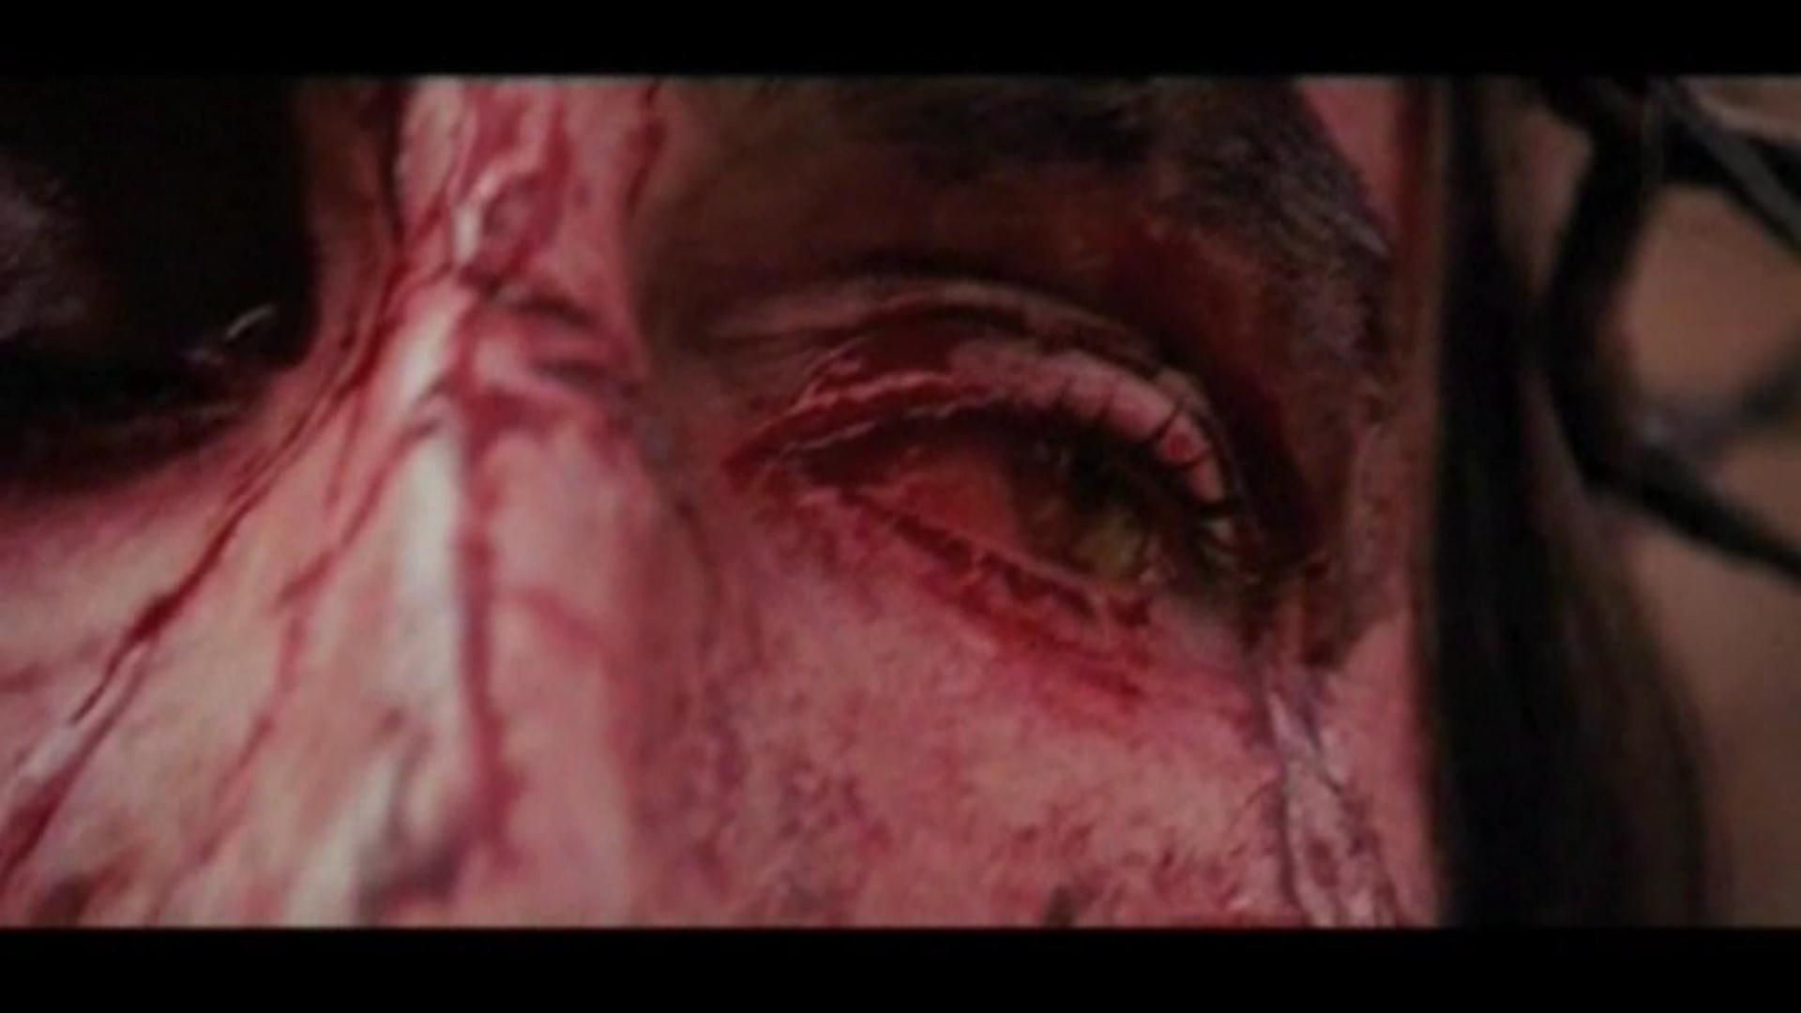
fÊiq iajdñ orefjda l=refiaa nfrka m<uqfjks jr ìu jefgk fial

Slide 8
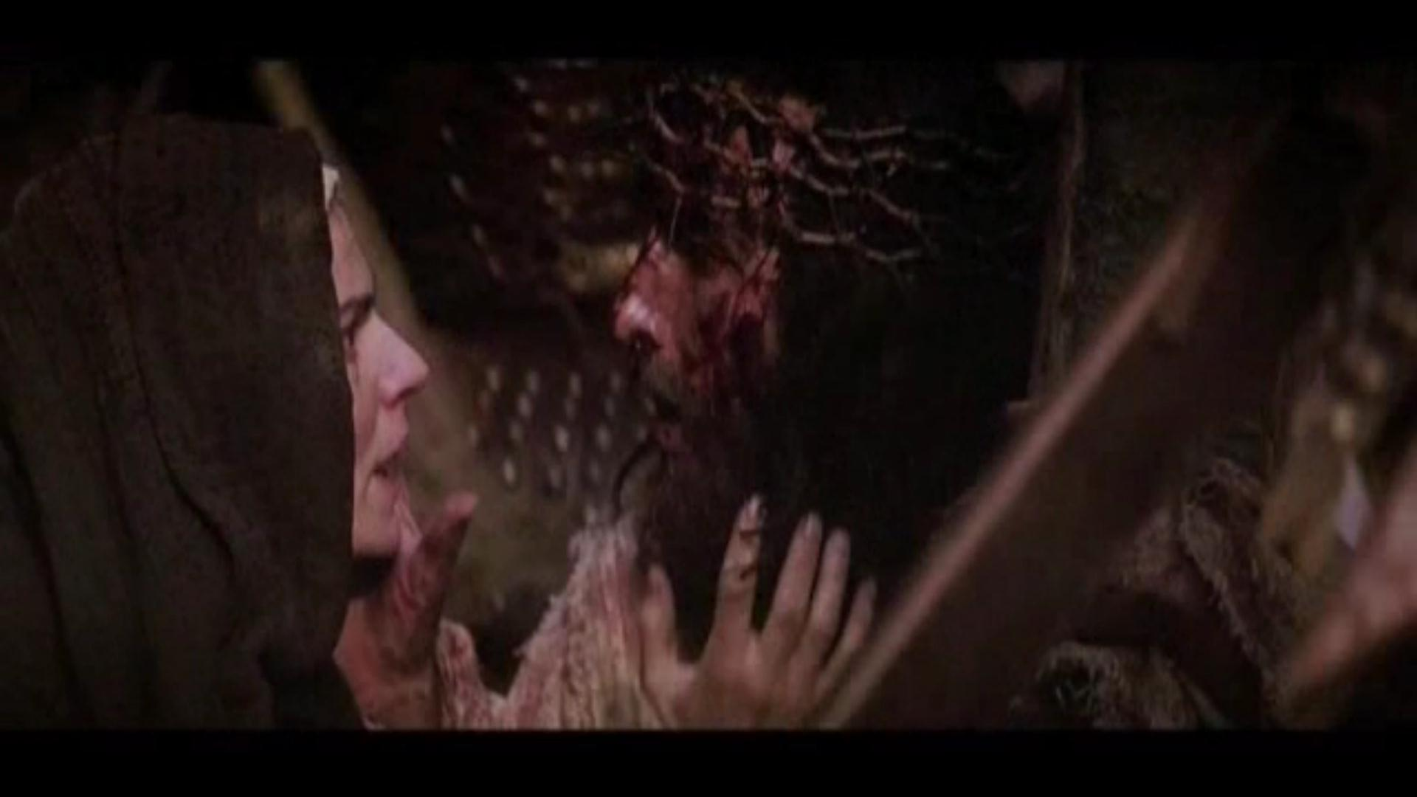
fÊiq iajdñ orejkag Wkajykafiaf.a msßisÿ uEKsfhda iïuqL jk fial

Slide 10
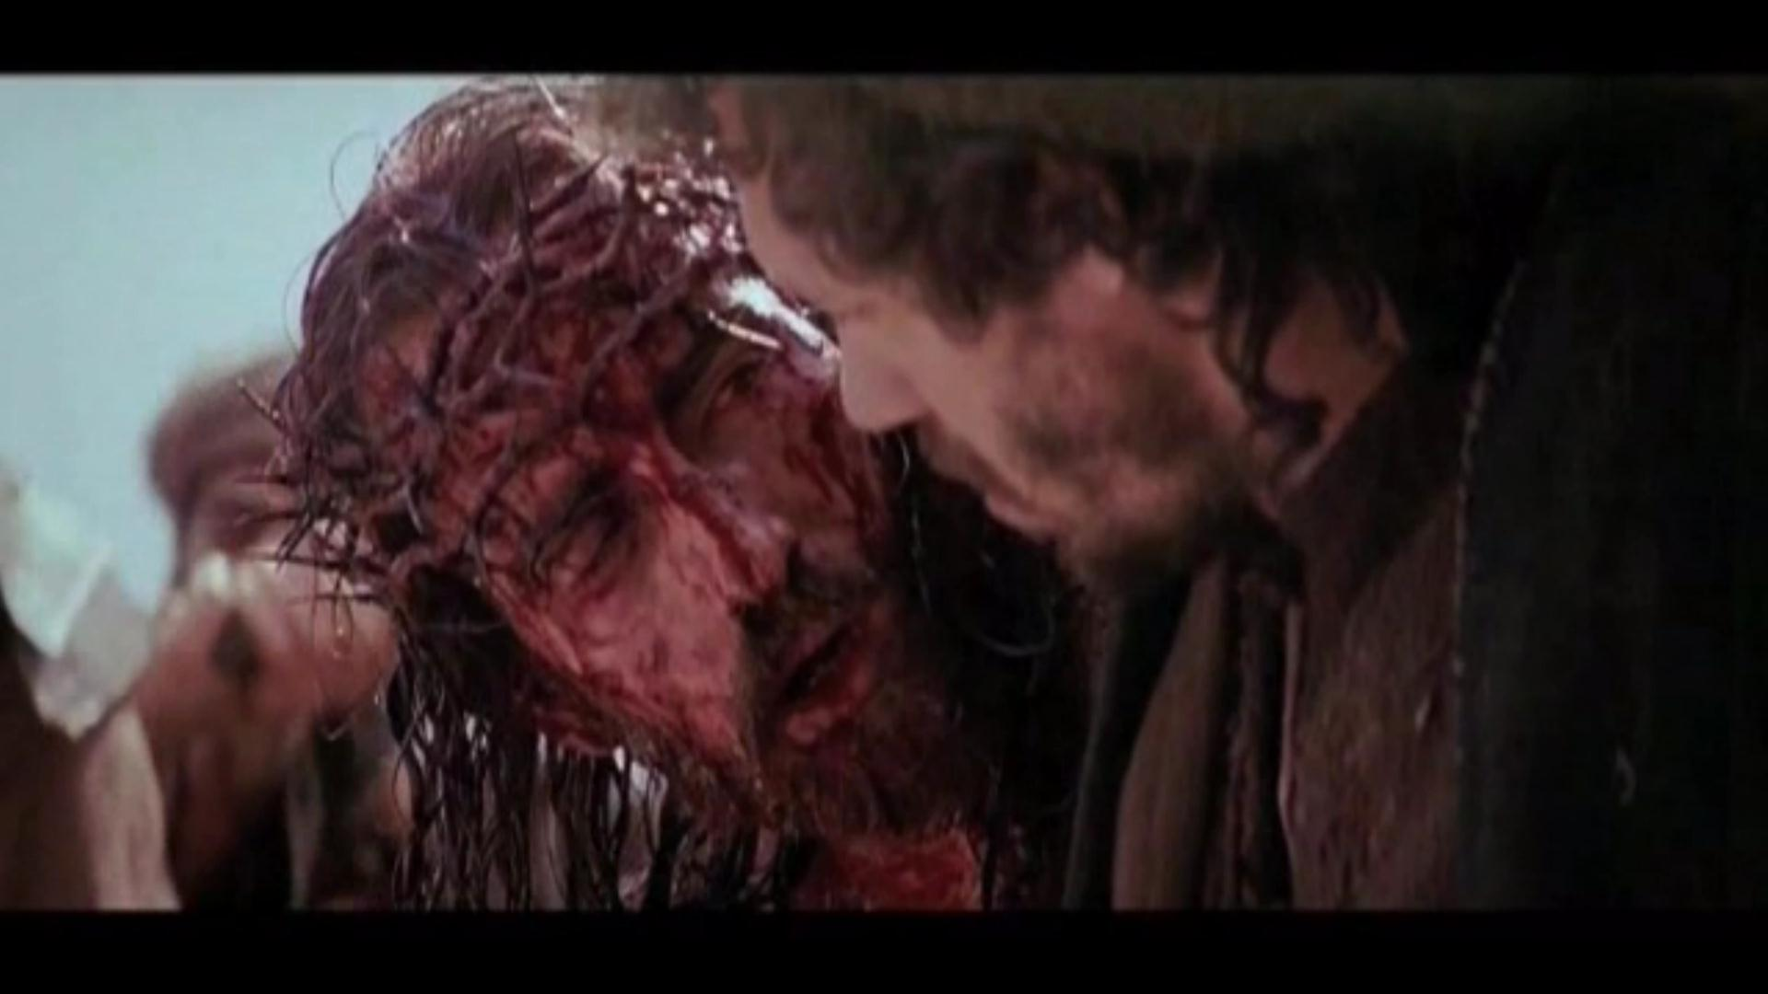
l=reih f.khk msKsi isfudka isßfkajqia fÊiqiajdñorejkag Woõfjhs

Slide 12
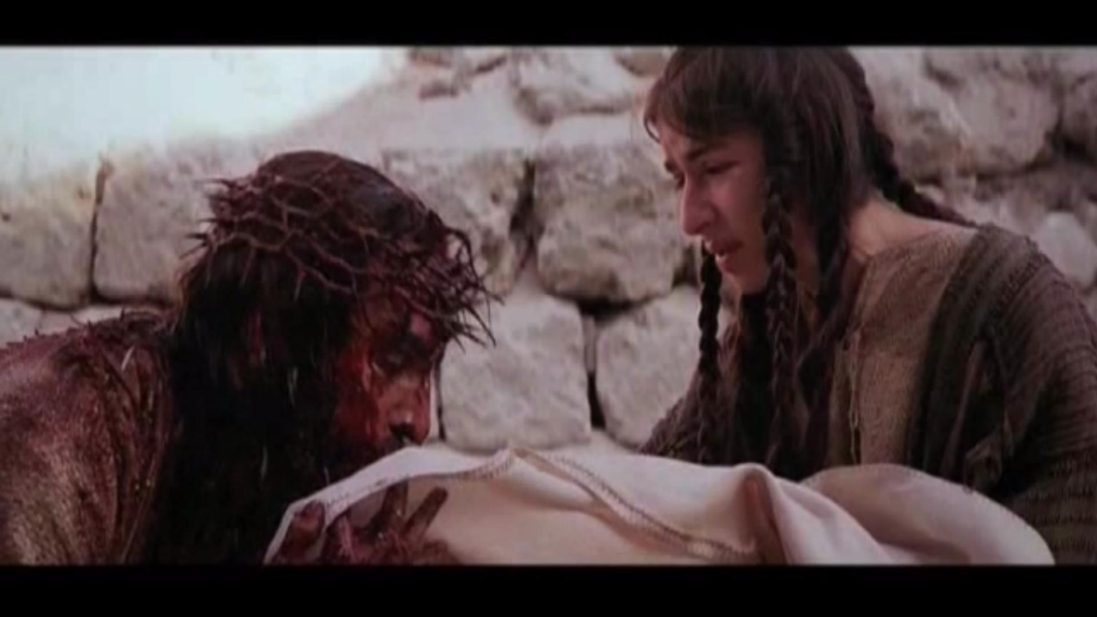
fjfrdaksld kï Nla;sjka; ia;%S fÊiq iajdñorejkaf.a Y%S uqyqK uKav,h msiouhs

Slide 14
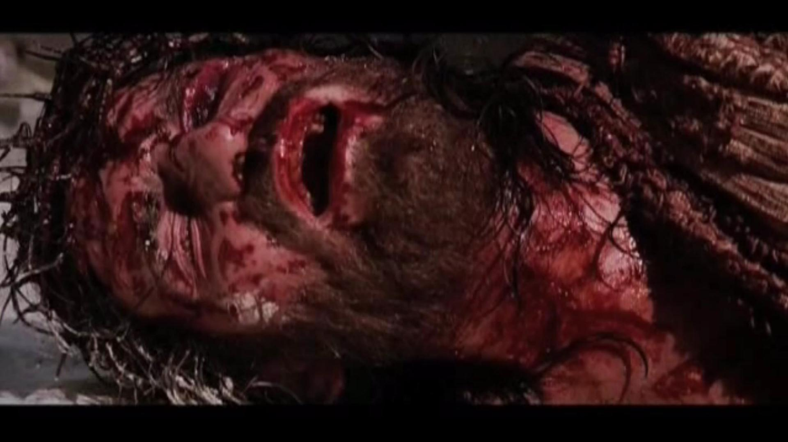
fÊiq iajdñorefjda l=refia nfrka fofjks jr ìu jefgkfial

Slide 16
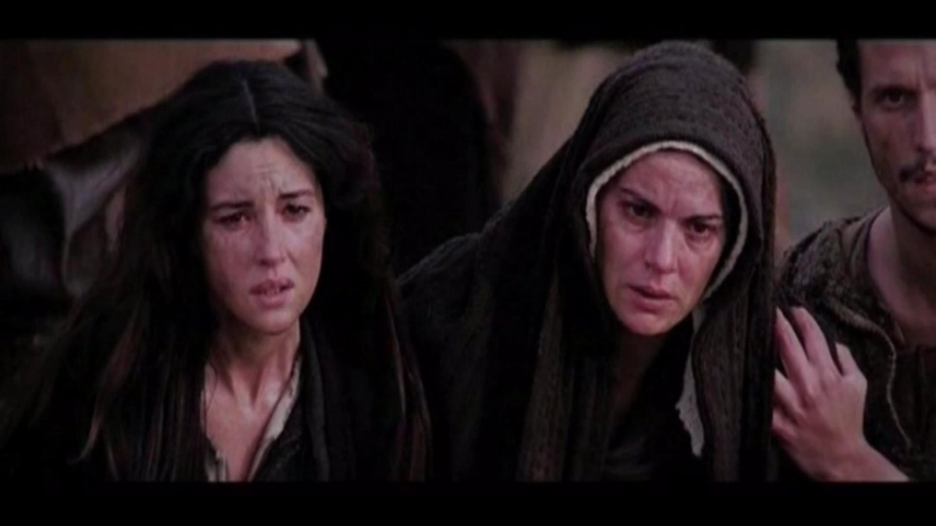
fÊiq iajdñorefjda fcrei,fï ia;%Ska ikid jodrkfial

Slide 18
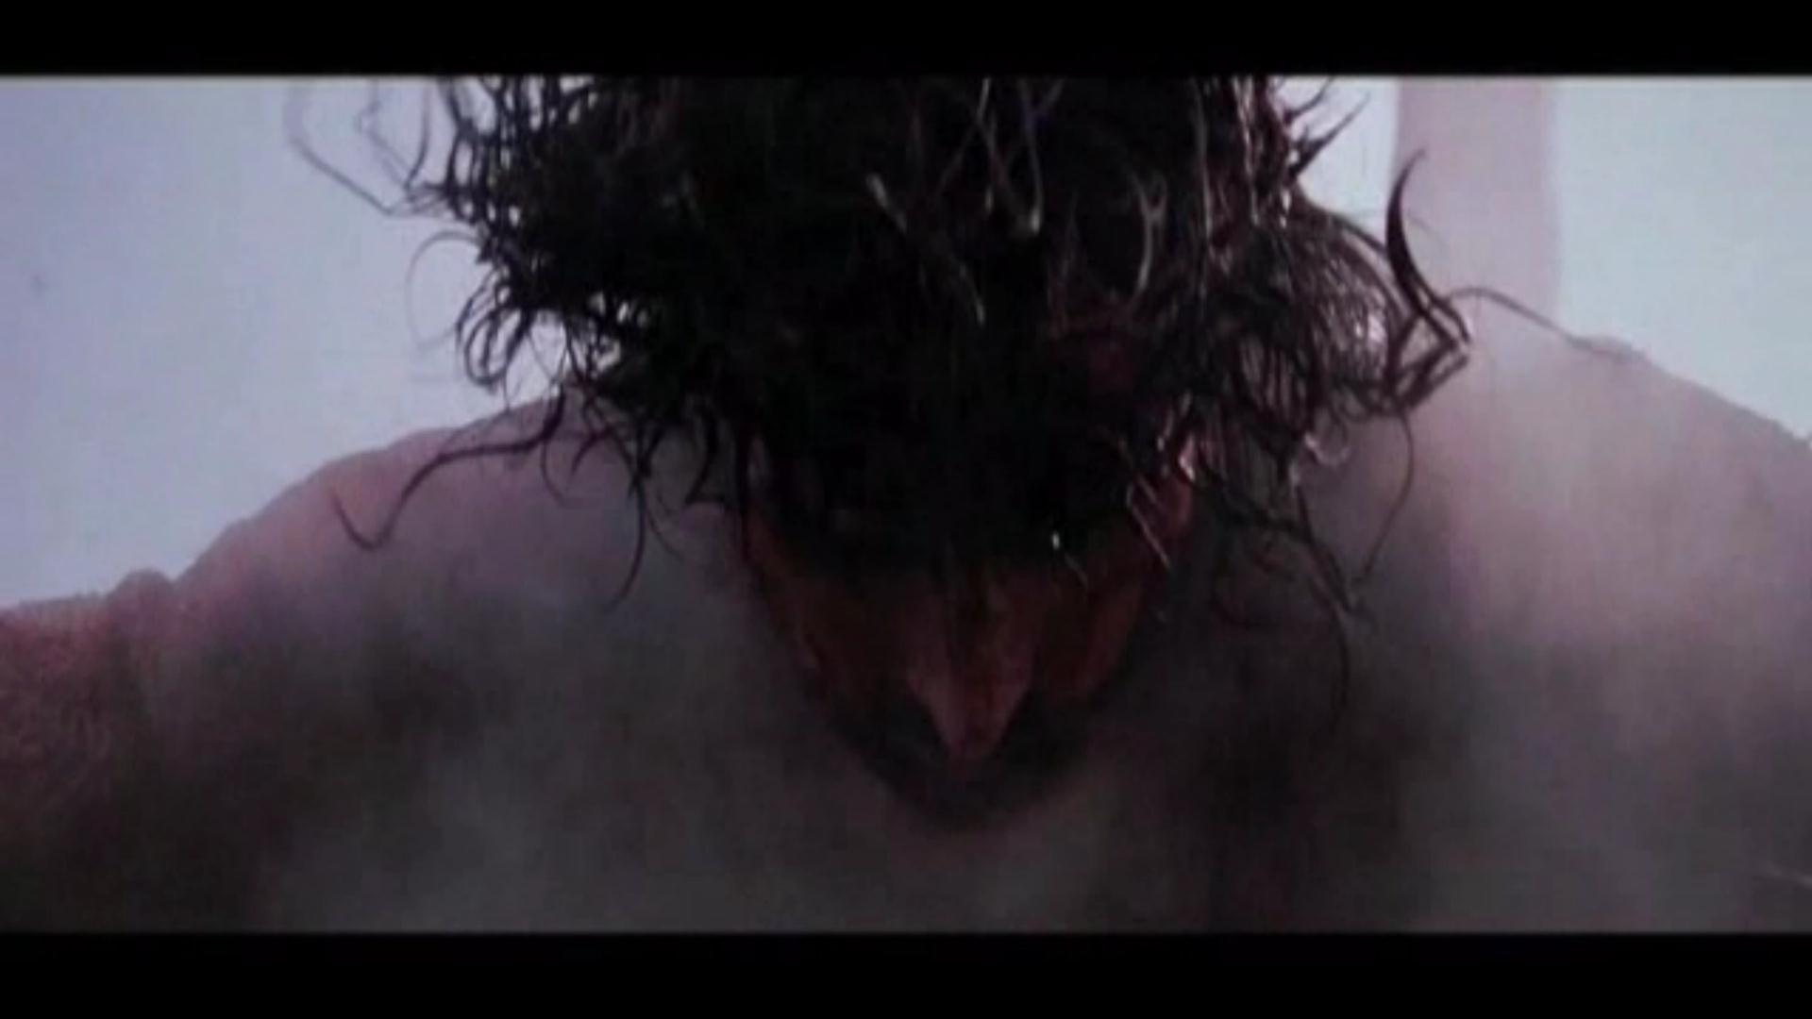
fmaiq iajdñorefjd l=refia nfrka ;=kafjks jr ìu jefgk fial

Slide 20
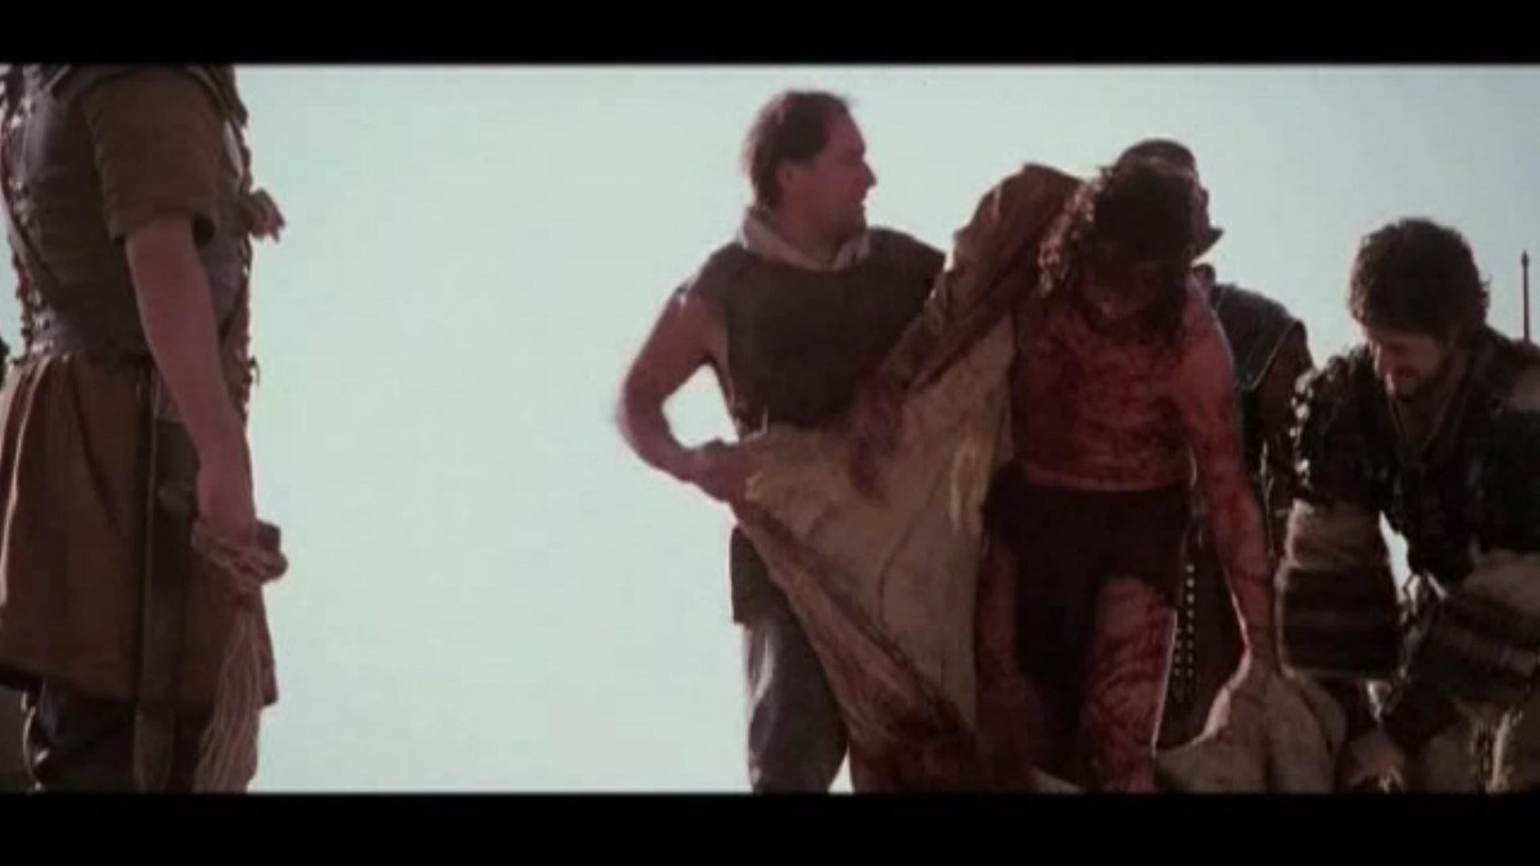
cqofhda fÊiq iajdñorejkaf.a jia;% lvd ou;s

Slide 22
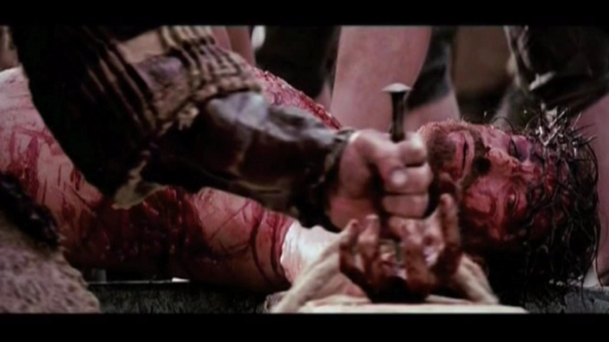
fÊiq iajdñorefjda l=reifha weK .ikq ,nk fial

Slide 24
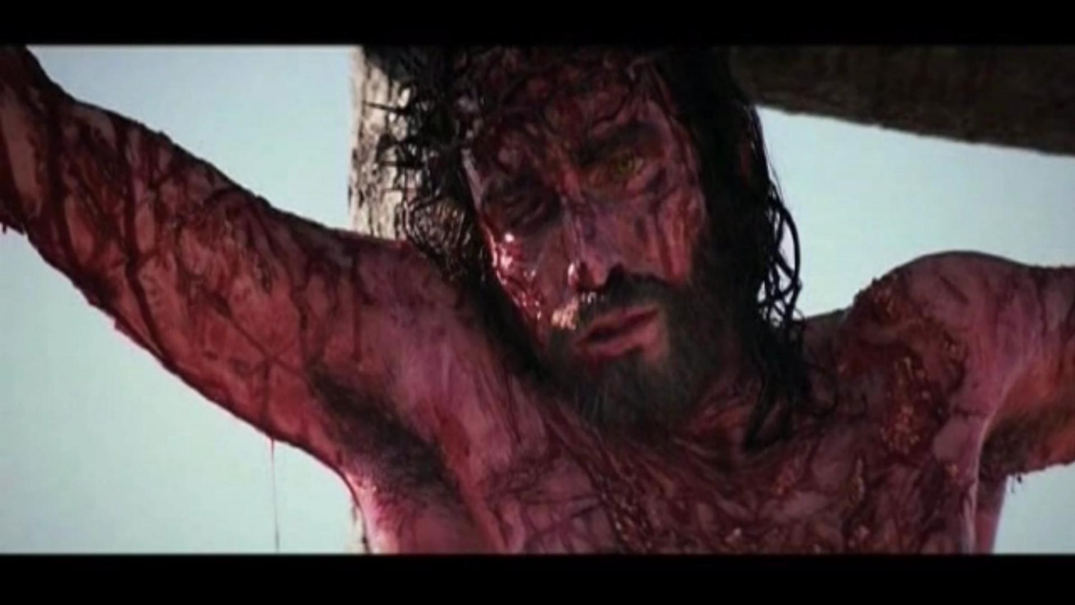
fÊiq iajdñorefjda l=reifhys Wl=;afjkfial

Slide 26
12 fjks ia:dkh
fÊiq iajdñorefjda l=reifhys Wl=;afjkfial

Slide 27
13 fjks ia:dkh
fÊiq iajdñorefjda l=reifhka ndk,ÿj ;ukajykafiaf.a msßisÿ uEKshkaf.a Wl=f,ys mqkjkq ,nkfial

Slide 28
14 fjks ia:dkh
fÊiq iajdñorefjda .,af,fkys ;ekam;a lsrkq ,nkfial

